Slide 1

Amazon Sales (Datawarehouse and Data Mining)
COHNDSE232F - 006 – H.G.K.Achintha
COHNDSE232F – 028 - H.P.Kavindi
COHNDSE232F – 053 - M.M.Madanayake
COHNDSE232F – 054 - T.T.Liyanaarachchi
COHNDSE232F –069 -M.S.Mohotti

Slide 2
Introduction
This dataset provides detailed information about products listed on Amazon, focusing on their attributes, pricing, customer feedback, and related metadata. The data is essential for analyzing trends in sales, customer preferences, and pricing strategies.

Slide 3
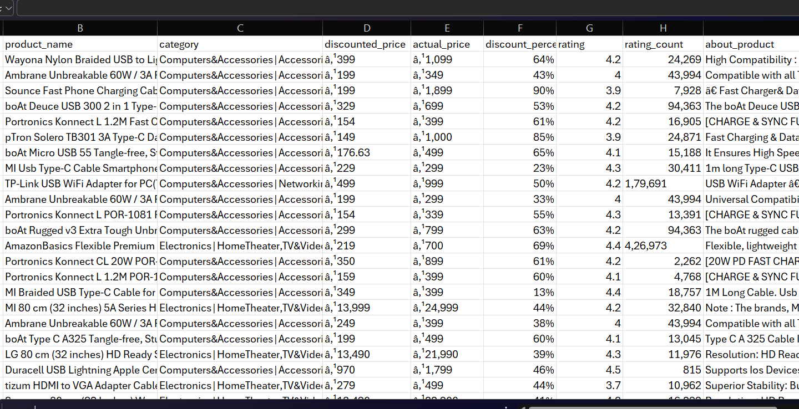
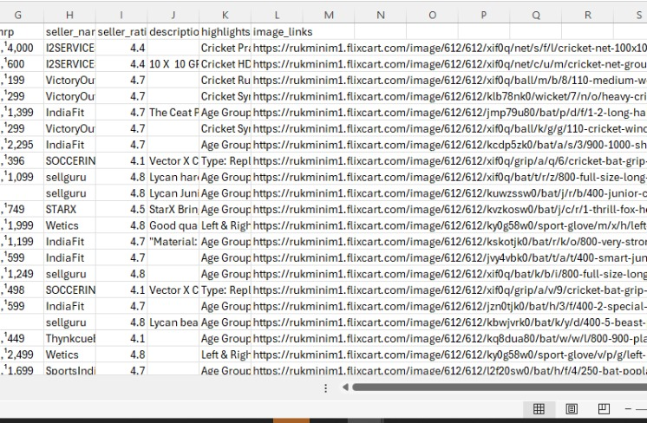
Dataset Overview
CVS Files
Schema Design:
Galaxy Schema for historical data.
Fact Table:
Sales
Dimension Tables:
Customer
Product
Date

Slide 4
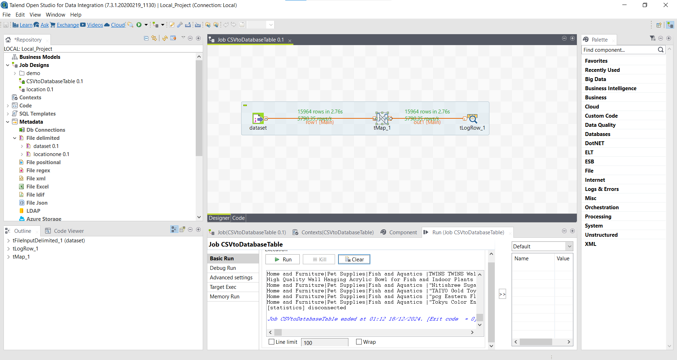
CVStoDatabase

Slide 5
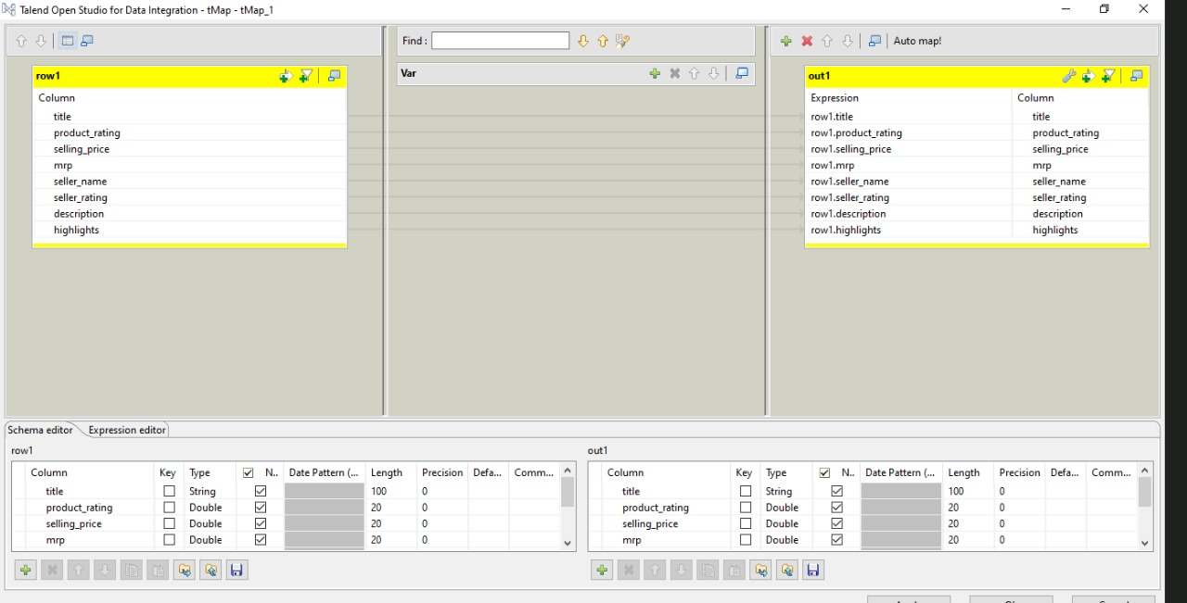
tMap

Slide 6
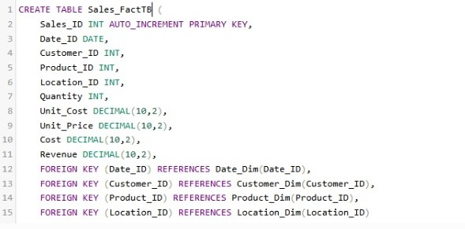

Slide 7
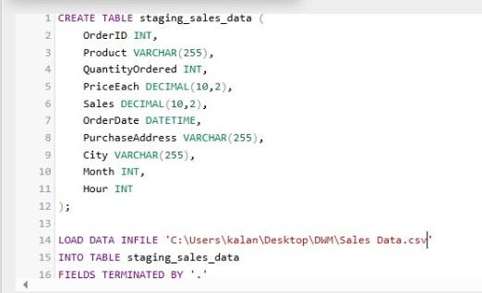
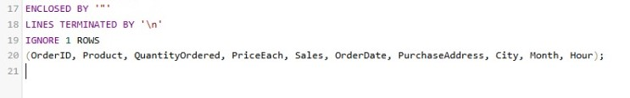

Slide 8
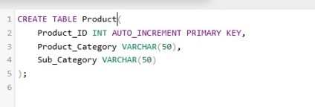
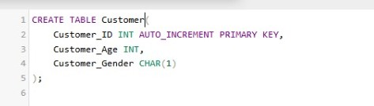
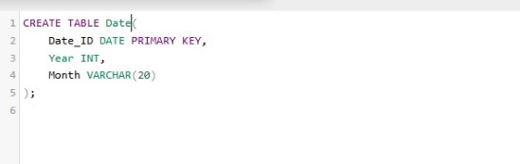
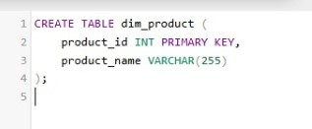
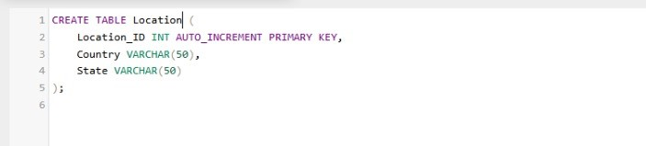
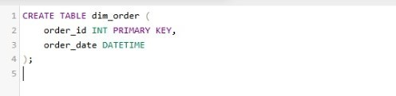

Slide 9
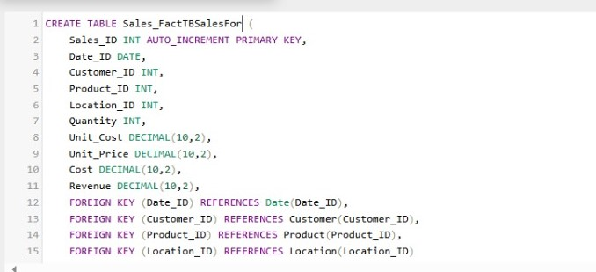
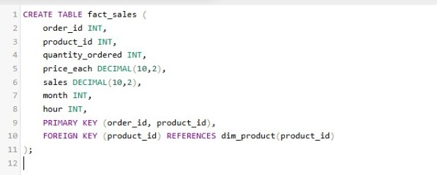

Slide 10
ETL Process Using Talend
ETL Operations:
- Extraction: Data source integration.
- Transformation: Data cleansing, renaming fields, and metric calculations.
- Loading: Dimension tables first, then fact tables.
Automation: Scheduled workflows for regular updates.

Slide 11
Project Deliverables
BI Dashboard (.pbix)
SQL Scripts for database schema.
ETL Workflows in Talend.
Power BI

Slide 12
Data Visualization in Power BI
Dashboard connection to oracle database
Key Visualization
Sales Trends
Product Ratings Distribution
Category Wise Sales Performance
Top Products by Sales
Customer Interaction
Dashboard Design :Interactive layout with filter and clear labels

Slide 13
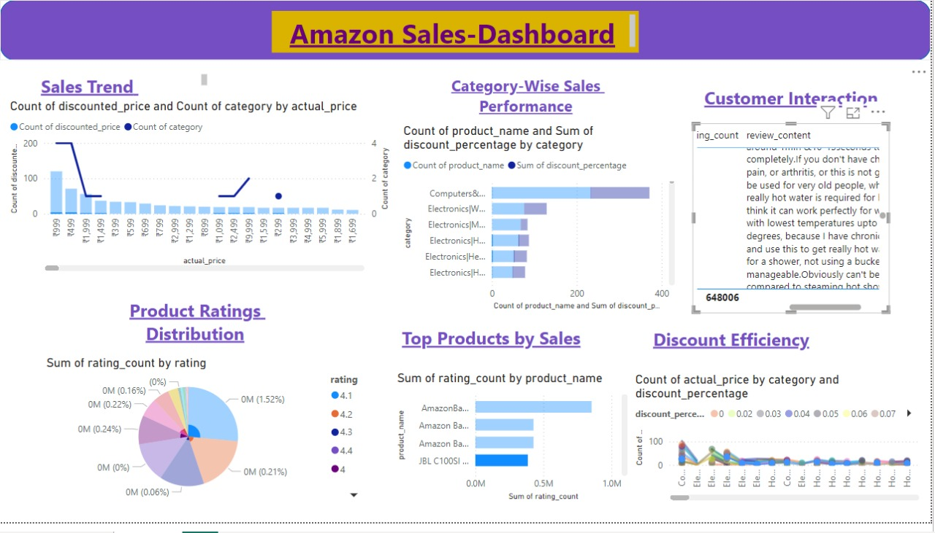
Data Visualization in Power BI

Slide 14
Evaluation and Outcomes
Key Results:
- Efficient data integration and storage.
- Actionable insights from analytics.
Recommendations:
- Extend schema for additional processes.
- Automate ETL processes for scalability.
Learning Achievements:
- Practical application of data warehousing concepts.
- Improved skills in ETL and BI tools.

Slide 15



Tools

Slide 16
Conclusion
Used Talend, SQL Developer and Power BI to analyze Amazon sales data.
Implemented a structed schema, ETL processes and interactive dashboard.
Gained Practical skills in data warehousing and business intelligence tools.
Recommended extending the schema and automating workflows.

